Slide 1
Project Dimensions and Life Cycle
Week 2

Slide 2
Week 2 Roadmap
Session 1
Session 2
Four project dimensions
Classic mistakes
Projects vs operations
Project life cycle
Phases and process groups
Phase-to-phase relationships
Product vs project life cycle
Notes:
Session 1 (today): the four project dimensions, classic mistakes, and projects vs operations.
Session 2: life cycle, phases, phase relationships, and product vs project life cycle.

Slide 3
What Killed Your Project?
The board
1
Think of a semester project, group assignment or FYP stage that went badly
?
?
?
?
2
Write the ONE biggest reason on a slip of paper
Notes:
ACTIVITY 1 [~10 min] - do this BEFORE showing the four dimensions.
1. Give 1 minute of silent thinking: a semester project, group assignment or FYP stage that went badly.
2. Each student writes ONE biggest reason on a sticky note or paper slip. One reason only, short phrase.
3. Collect the slips. Read 8-10 aloud and stick/write them on the board in four columns WITHOUT labels. Group similar ones together as you go.
4. Ask the class: "What do the notes in each column have in common?" Let them try to name the columns.
5. Reveal the labels: People, Process, Product, Technology (next slide).
Expected result: most notes land in People (teammate didn't contribute, poor communication) and Process (started late, no plan). Very few in Technology. That is the whole point of the next slides: "It's always a people problem."
Tip: keep the slips. You can reuse them when you reach the Classic Mistakes slides.

Slide 4
Four Project Dimensions
People
Process
Product
Technology
Notes:
Peopleware issues
10-to-1 difference in Dev productivity
Teams 3 or 5 to 1 diff
Process
Dev basics, risk mgmt, QA, lifecycle planning, customer orientation
Product
Most tangible dimension
Technology

Slide 5
People
“It’s always a people problem” Gerald Weinberg, “The Secrets of Consulting”
Developer productivity
Improvements:
  Team selection
  Team organization
  Motivation
Notes:
Teams: 5-to-1 range

Slide 6
People
Other success factors
  Matching people to tasks
  Career development
  Balance: individual and team
  Clear communication

Slide 7
Process
Is process stifling?
2 Types: Management & Technical
  Development fundamentals
  Quality assurance
Risk management
Lifecycle planning
Notes:
Stfling= very hard
cut time-to-market
Improve quality

Slide 8
Product
Product is the final production of the project.

Slide 9
Technology
Often the least important dimension
Language and tool selection
Value and cost of reuse

Slide 10
Classic Mistakes
One bad apple can spoil your whole project.
Some ineffective development practices have been chosen so often, by so many people, with such predictable, bad results that they deserve to be called “classic mistakes.”
Types
  People-Related
  Process-Related
  Product-Related
  Technology-Related
Notes:
Seductive: good reason for decisions at the time
Some are IT, most not
We’ll visit these throughout course
Gilligan’s Island: new scheme, get off island, seems to work, then fails
Being aware can help prevent
Class discussion

Slide 11
Mistake Detective: UniConnect Portal
The Vice Chancellor wants a new student portal live before admissions open in 3 months. The vendor estimated 6 months, but the IT head said “we’ll manage.” The team spends the first five weeks waiting for the Registrar’s office to sign off on requirements. To save time, they skip design and start coding straight away. Ahmed, the senior developer, insists on rewriting the backend in a new framework he has wanted to try, saying it will “double our speed.” The Registrar keeps adding features: a chatbot, a mobile app, a fee-installment calculator. No students were ever asked what they need. Code is shared through WhatsApp and USB drives. One developer skips meetings and ignores code reviews, but the manager never addresses it. Two weeks before launch, testing is cut from three weeks to three days, and four new developers are hired to “speed things up.” The team pulls all-nighters, and the manager praises Ahmed as the hero.
Find & label each mistake:
People
Process
Product
Technology

Slide 12
Mistake Detective: Answer Key
Clue in the case | Classic mistake | Category
“We’ll manage” 3 months vs 6 | Optimistic schedule, wishful thinking | Process
Five weeks waiting for sign-off | Wasted time in the fuzzy front end | Process
Skip design, start coding | Shortchanged upstream, code-like-hell | Process
New framework to “double our speed” | Silver bullet, developer gold-plating | Technology
Chatbot, app, calculator added | Feature creep, requirements gold-plating | Product
Students never asked | Lack of user input | People
Code on WhatsApp and USB | No source-code control | Technology
Developer skips meetings, unaddressed | Uncontrolled problem employee | People
Testing cut to three days | Shortchanged quality assurance | Process
Four new hires before launch | Adding people to a late project | People
All-nighters, Ahmed the hero | Heroics | People
Notes:
DEBRIEF [~8 min]
Reveal the answer key row by row (or let groups call out each one before you reveal).
Points to stress:
- Optimistic schedule + wishful thinking: McConnell calls wishful thinking possibly the biggest single cause of problems in software development. "We'll manage" is the classic phrase.
- Shortchanged QA: one day of QA skipped early can cost 3-10 days later.
- Shortchanged upstream: a requirements or design defect fixed late can cost 10-100 times more.
- Adding people to a late project: we will demo this right after the next slide.
- Heroics: when a company depends on one hero, it is being held hostage. Ask: "Does your FYP group have a hero?"
Some items fit more than one category - accept any well-argued answer. The skill is noticing, not memorizing.
Transition: "The next slides are the complete catalogue. You have already found most of them." Move through slides 9-15 quickly (about 1.5 minutes each).

Slide 13
People-Related Mistakes Part 1
Undermined motivation
Weak personnel
  Weak vs. Junior
Uncontrolled employee’s problems
Heroics
Adding people to a late project
Notes:
Motivation: studies show has largest impact
Don’t undermine Morale
2nd greatest influence on productivity
Junior != bad
Uncontrolled: most common developer complain about their managers
Heroics. Company hostage.
“Can-do”, “how high” attitudes
Brooks, reading assignment

Slide 14
People-Related Mistakes Part 2
Noisy, crowded offices
Customer-Developer friction
Unrealistic expectations
Politics over substance
Wishful thinking
Lack of effective project sponsorship
Lack of user input
Notes:
60%of developers feel unsatisfactory environment: need quite and privacy
MS offices
Friction: classic differing viewpoints
Results in ‘poor communication’
Passive-aggressive
Realistic Expectations: 1 of top 5 reasons for success of in-house projects
Perception woe
Politics
Managing-up
Wishful
Cognitive dissonance
Closing your eyes and hoping
McConnell: maybe causes the most problems in software development

Slide 15
Identify People Mistakes
A software project is 2 months behind schedule. The manager hires 5 junior developers, asks the senior developer to work every weekend, ignores conflicts between two team members, and tells everyone to “work harder.”
Notes:
adding people to a late project, heroics, weak personnel, undermined motivation, and uncontrolled employee problems.

Slide 16
Identify People Mistakes
A university is developing a new LMS. The manager promises delivery in 6 weeks despite estimates showing it needs 4 months. Teachers are not consulted about their requirements. Senior management does not help when resources are needed. The manager keeps saying, “We'll catch up later.” Meanwhile, developers work in an overcrowded office and the client keeps demanding new features.
Notes:
Unrealistic expectations
Lack of user input
Lack of effective project sponsorship
Wishful thinking
Noisy/crowded offices
Customer–developer friction

Slide 17
Process-Related Mistakes
Optimistic schedules
Insufficient risk management
Contractor failure
Insufficient planning
Abandonment of plan under pressure
Wasted time during fuzzy front end
Shortchanged upstream activities
Inadequate design
Shortchanged quality assurance
Notes:
Similar to wishful thinking
Puts unnecessary pressure
Risk Mgmt:
Risks will manage you
Contractor: late, poor quality, or fails to meet specifications
Requires lots of management
Insufficient planning: “if you don’t care where you’re going, any plan will do”
Abandonment
Out the window
Fall into code-and-fix mode

Slide 18
Identify Process-Related Mistakes
A software company is developing a hospital management system. The manager promises delivery in two months even though the team estimates five months. Requirements have not been finalized, but developers have already started coding. The customer keeps requesting new features and the manager accepts all of them. Testing time is reduced because the deadline cannot be changed.

Slide 19
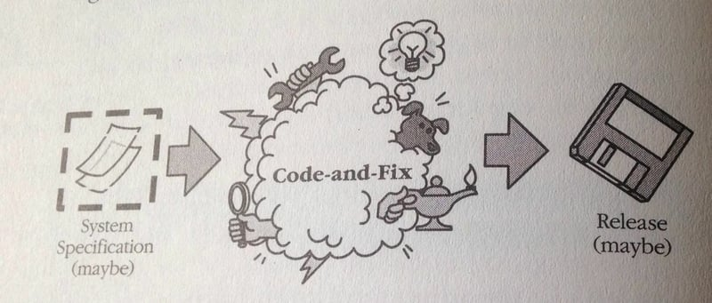
Process-Related Mistakes Part 3
Insufficient management controls
Frequent convergence
Omitting necessary tasks from estimates
Planning to catch-up later
Code-like-hell programming
Notes:
Management controls
Need to be able to track
We’ll cover lots of these
PMI
Convergence
Waste of time
Missing tasks
Often 20-30% of a schedule
Catch-up later
How many times have you seen a project catch-up?
Only by all-nighters
Like hell
“Entrepreneurial” approach
See catch-up later
"Code like hell" programming is a software development approach that involves writing code quickly and fixing issues as they arise. It's also known as the "code and fix" model.

Slide 20
Product-Related Mistakes
Requirements gold-plating
  Gilding the lily
Feature creep
Developer gold-plating
  Beware the pet project
Push-me, pull-me negotiation
Research-oriented development
Notes:
Gold
Gilding the lily
Performance is required more often than need be
Feature creep
25% average change in req.
Dev. Gold
Nifty new technology
Pet project
Push-me
Slip schedule + add features
Research vs. Development

Slide 21
Identify Product Related Mistakes
“The customer asked for a simple attendance system. The developer added facial recognition because he thought it was cool. Then the department requested SMS alerts, the project manager wanted an AI dashboard, and another developer decided to experiment with a new AI algorithm. The team spent two months arguing about what should be included.”

Slide 22
Technology-Related Mistakes
Silver-bullet syndrome
Overestimated savings from new tools and methods
  Fad warning
Switching tools in mid-project
Lack of automated source-code control
Notes:
who’s heard of ‘silver bullet’ (not the beer)
SCM
Jones: 10% month, I see more

Slide 23
Project vs operations

Slide 24
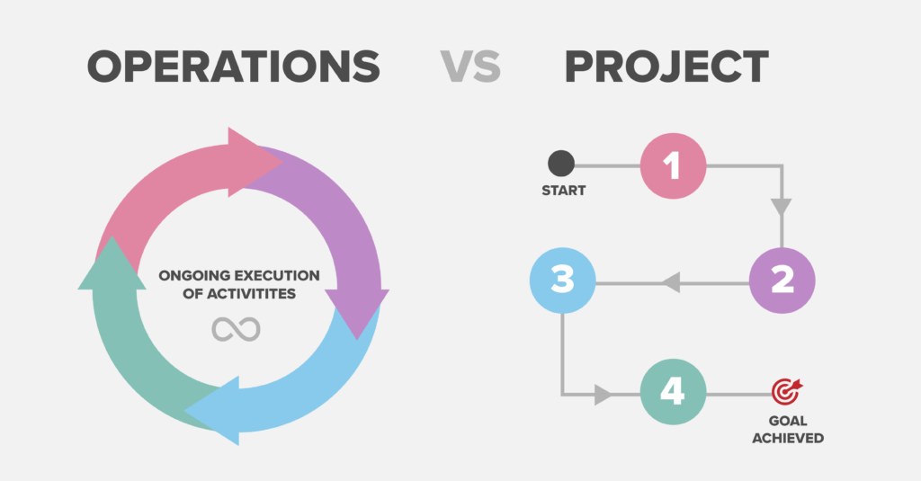

Slide 25
Projects vs Operations
Organizations perform work to achieve a set of objectives.
Categories of Organizational Work:
PROJECT work
OPERATIONS work.
Shared Characteristics of Project and Operations Work:
  Performed by individuals,
  LIMITED BY CONSTRAINTS, including resource constraints,
  Planned, executed, monitored and controlled [MANAGED], and
  Performed to achieve organizational objectives or strategic plans.

Slide 26
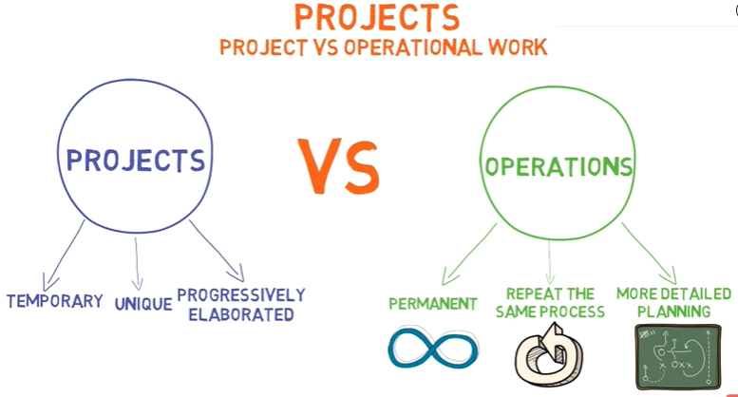

Slide 27
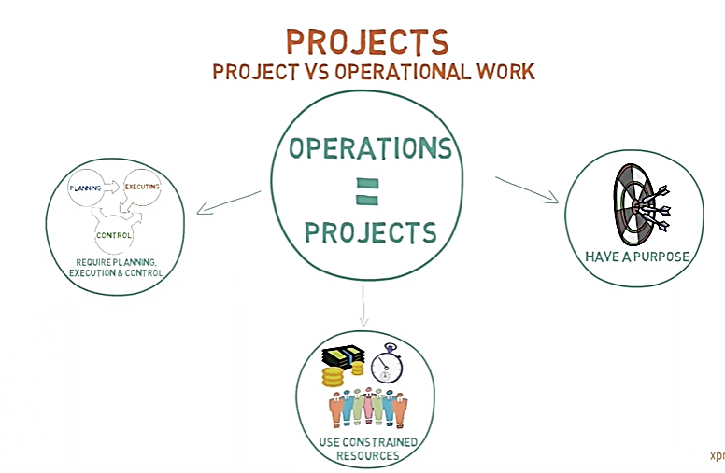

Slide 28
Projects vs Operational Work
Differences between Project and Operations Work:
Primary Difference:
Operations are ongoing and produce repetitive products, services, or results.
Projects (along with team members and often the opportunity) are temporary and end.
Operations work is ongoing and sustains the organization over time.
Operations work does not terminate when its current objectives are met but instead follow new directions to support the organization’s strategic plans.

Slide 29
Projects vs Operational Work
Operations work supports the business environment where projects are executed.
As a result, there is generally a significant amount of interaction between the operations departments and the project team as they work together to achieve project goals.
An example of this is when a project is created to redesign a product. The project manager may work with multiple operational managers to
research consumer preferences,
draw up technical specifications,
build a prototype,
test it, and
begin manufacturing.

Slide 30
Projects vs Operational Work
The team will interface [or interact] with the operational departments to determine the manufacturing capacity of current equipment, or to determine the most appropriate time to transition production lines to produce the new product.
The amount of resources supplied from operations will vary from project to project.
One example of this interaction is when individuals from operations are assigned as dedicated project resources. Their operational expertise is used to carry out and assist in the completion of project deliverables by working with the rest of the project team to complete the project.

Slide 31
Projects vs Operational Work
Depending on the nature of the project, the deliverables may modify or contribute to the existing operations work. In this case, the operations department will integrate the deliverables into future business practices.
Examples of these types of projects can include, but are not limited to:
  Developing a new product or service that is added to an organization’s product line to be marketed and sold,
  Installing products or services that will require ongoing support,
  Internal projects that will affect the structure, staffing levels, or culture of an organization, or
  Developing, acquiring, or enhancing an operational department’s information system.

Slide 32
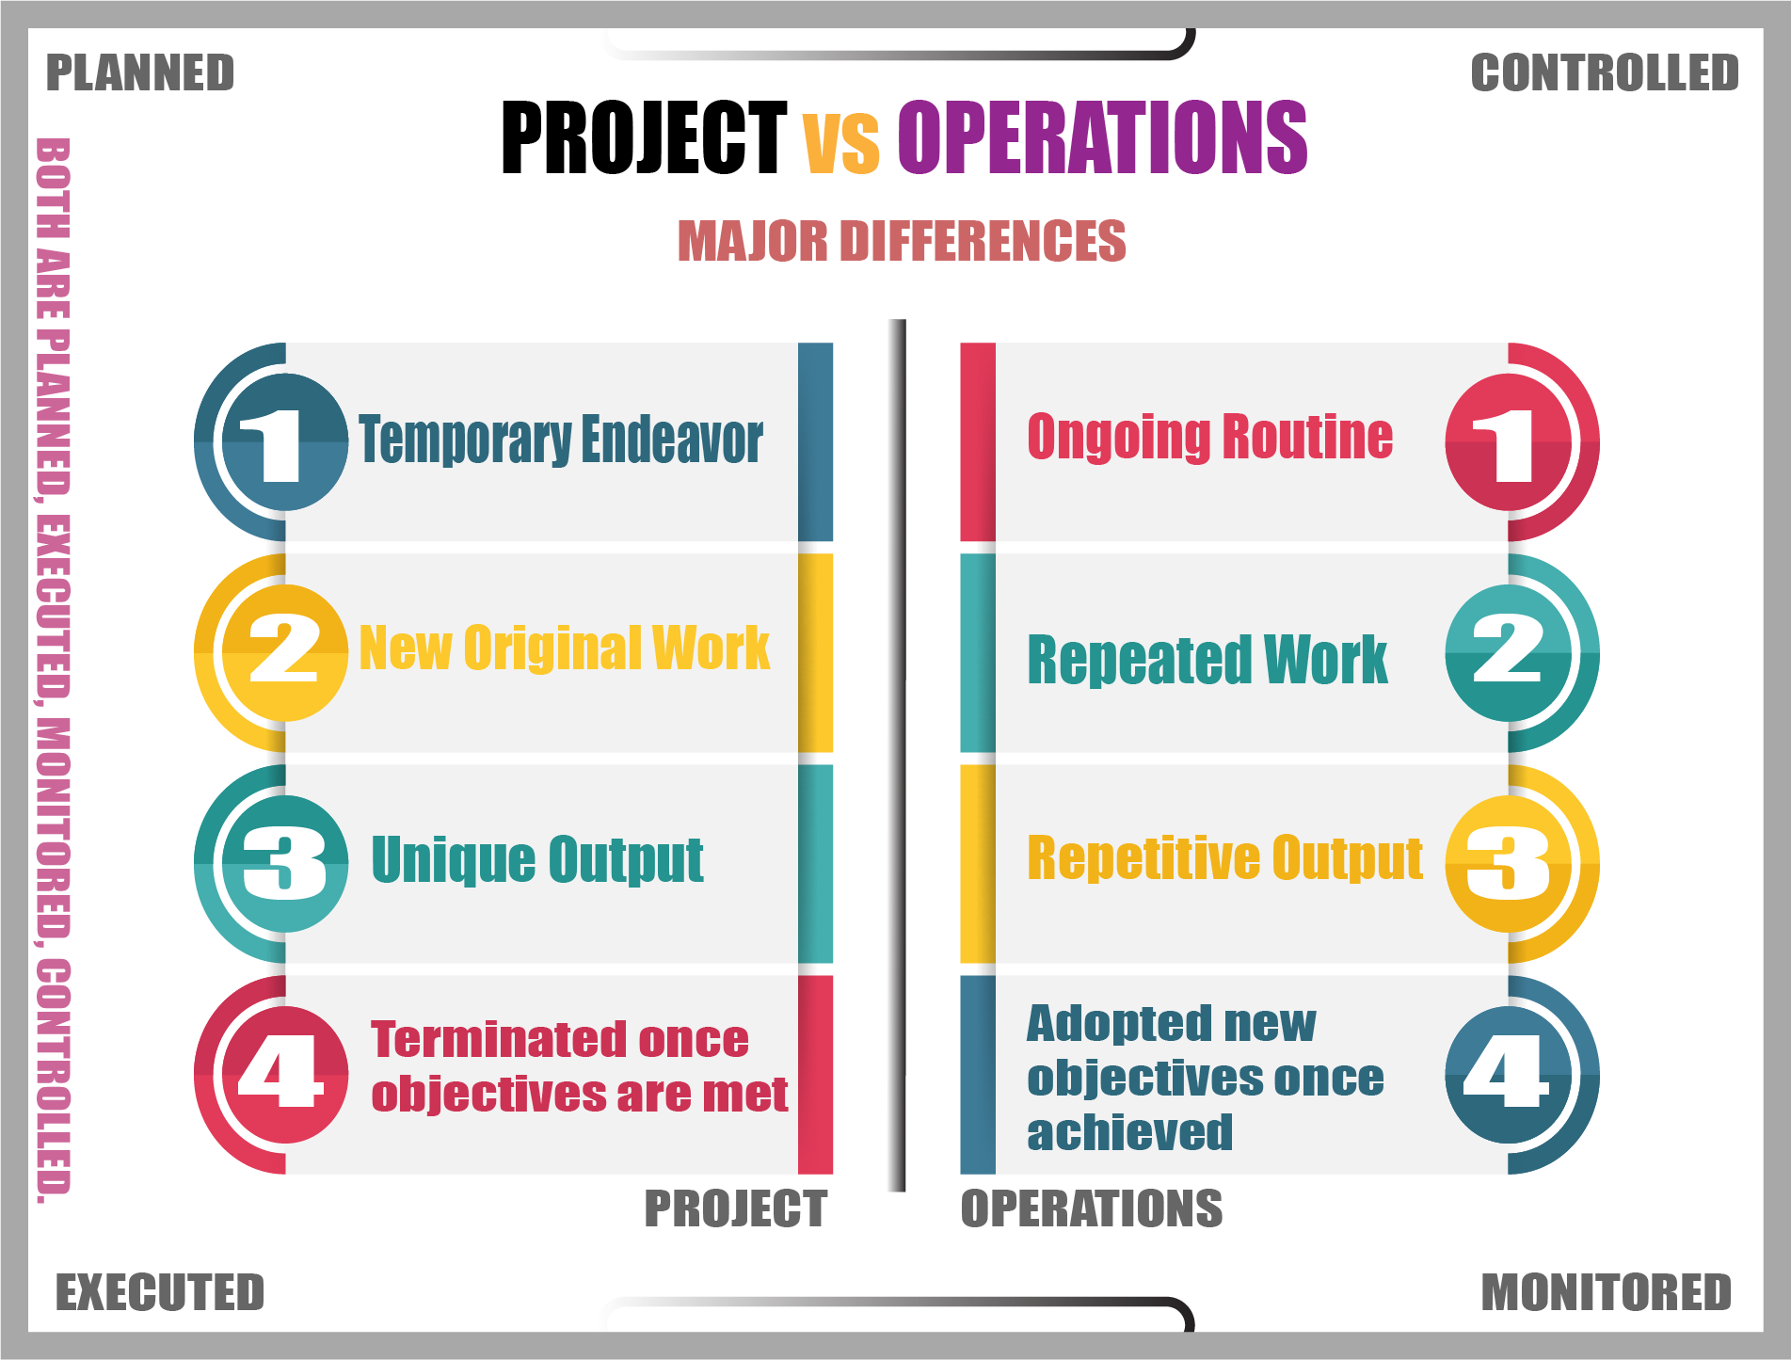

Slide 33
Project VS Operation
Project
Operation
Ongoing, day-to-day activities
Routine and Repetitive Work
When current objectives are met Operations do not terminate, but follow new directions to support the organization’s strategic plans.
Examples:
Taking class notes
Responding to a supply-chain request
Routine manufacture of an Apple iPod
Projects are temporary, and have a beginning and an end.
Produce unique products, services, or results.
When current objectives are met Projects are closed. Any New directions may result in initiation of new projects.
Examples:
Writing a term paper
Developing a supply-chain information system
Designing an iPod that is approximately 2 X 4 inches, interfaces with PC, and stores 10,000 songs
Notes:
https://www.iliyanastareva.com/blog/the-difference-between-projects-and-operations

Slide 34
Is it a Project?
Consider the following scenario: You work for a wireless phone provider, and the VP of marketing approaches you with a fabulous idea – “fabulous” because he’s the big boss and because he thought it up. He wants to set up Stalls in local grocery and big–box stores as mini–offices. These offices will offer customers the ability to sign up for new wireless phone services, make their wireless phone bill payments, and purchase equipment and accessories. He believes that the exposure in grocery stores will increase awareness of the company’s offerings. After all, everyone has to eat, right? He told you that the board of directors has already cleared the project, and he will dedicate as many resources to this as he can. He wants the new Stalls in place in 12 stores by the end of this year. The best news is he has assigned you to head up this project.

Slide 35
Your Verdict: Is It a Project?
Temporary?
Unique result?
Is there a clear start and end?
Does it create something new?
Constrained?
Objectives?
Which limits on time and resources?
What is it meant to achieve?
once the stalls are open, what becomes operations work?
Notes:
- Temporary: yes - deadline "by the end of this year".
- Unique result: yes - 12 new stalls that did not exist before.
- Constrained: yes - resources ("as many as he can", which is vague - a risk!) and a fixed deadline.
- Objectives: yes - increase awareness and sign-ups.
Verdict: it is a project.
once the stalls are open, signing up customers, taking bill payments and selling accessories every day is OPERATIONS. The project creates the stalls; operations runs them.
Extra discussion: spot any classic mistakes in the scenario - the "fabulous" idea from the boss (politics over substance?), vague resources, a fixed deadline set before planning (optimistic schedule).

Slide 36
Project or Operation
Each day a plumber fixes leaks in 20 different locations. Each leak may require a different solution (some may need a new washer, or a new pipe, or some putty), is it project or operation?
But let’s say during a leak fix, he realizes that the whole tubing is weak, damaged at many locations, and is going to explode at any time. Thus, he informs the home owner that a “Redesign the bathroom” should be undertaken if you want a permanent fix. Now is it a project or operation?

Slide 37
Project or Operation (Solution)
A plumber may be doing a support work to fix a leak. Each day he fixes leaks in 20 locations. Each leak may require a different solution (some may need a new washer, or a new pipe, or some putty), but it is still support work.
But let’s say during a leak fix, he realizes that the whole tubing is weak, damaged at many locations, and is going to explode at any time. Thus, he informs the home owner that a “Redesign the bathroom” project should be undertaken if you want a permanent fix, and the plumber can then give the details of the work required (scope), and a quotation (budget), and estimated time to fix the whole thing (schedule).
Notes:
Part 1 is operations (support work): variety in the details does not make it a project.
Part 2 becomes a project the moment it has its own scope, budget and schedule.
Key takeaway: a project is defined by scope, budget and schedule - which leads directly into next session's life cycle.
--- Original notes ---
https://www.solutionsiq.com/resource/blog-post/whats-the-difference-between-a-project-and-a-product/

Slide 38
Stand Up or Sit Down?
STAND UP = Project
STAY SEATED = Operation
1
K-Electric’s monthly billing
5
A bank handling daily cash deposits
2
Building the Karachi BRT Red Line
6
A bank moving to a new core banking system
3
Daraz processing today’s orders
7
Your Final Year Project
4
Daraz launching its 11.11 sale
8
Attending your weekly classes
Notes:
ACTIVITY 3: STAND UP OR SIT DOWN [~10 min]
Everyone stands for a project, stays seated for an operation. Read each item and give 3 seconds to decide.
Answers:
1. K-Electric's monthly billing - OPERATION (repetitive, ongoing)
2. Building the Karachi BRT Red Line - PROJECT (unique, has an end)
3. Daraz processing today's orders - OPERATION
4. Daraz launching its 11.11 sale campaign - PROJECT (temporary, specific goal and date)
5. A bank handling daily cash deposits - OPERATION
6. A bank migrating to a new core banking system - PROJECT
7. Your Final Year Project - PROJECT
8. Attending your weekly classes - OPERATION (for the student; the degree as a whole can be argued as a project - good debate)
Whenever the room splits, ask one person standing and one sitting to defend their choice. Write the criteria they use on the board: temporary vs ongoing, unique vs repetitive, has an end vs continues.
Transition: "You just discovered the textbook definitions. Let's confirm them."

Slide 39
Exit Ticket
Which classic mistake is your FYP group most at risk of right now?
And one thing you will do this week to prevent it.

Slide 40
The Project Life Cycle - Overview
Characteristics of a project life cycle

Slide 41
The Project Life Cycle - Overview
What is Project Life Cycle?
A project life cycle is a collection of generally sequential and sometimes overlapping project phases.
The phases are assigned names and numbers.
The name and number are determined by
the management and control needs of the organization or organizations involved in the project,
the nature of the project itself, and
its area of application.

Slide 42
The Project Life Cycle - Overview
The project life cycle can be determined or shaped by
the unique aspects of the organization,
Deliverables, and
activities that take place in between will vary widely with the project.
The life cycle provides the basic framework for managing the project, regardless of the specific work involved.

Slide 43
The Project Life Cycle - Overview
Generic Life Cycle Structure: Introduction
Projects vary in size and complexity.
No matter how large or small, simple or complex, all projects can be mapped to the following life cycle structure:
Starting the project
Organizing and preparing
Carrying out the project work
Closing the project.

Slide 44
The Project Life Cycle - Overview
Generic Life Cycle Structure: Benefits
It is often referred to when communicating with upper management or other entities
less familiar with the details of the project.
This high-level view can provide a common frame of reference for comparing projects—even if they are dissimilar in nature.

Slide 45
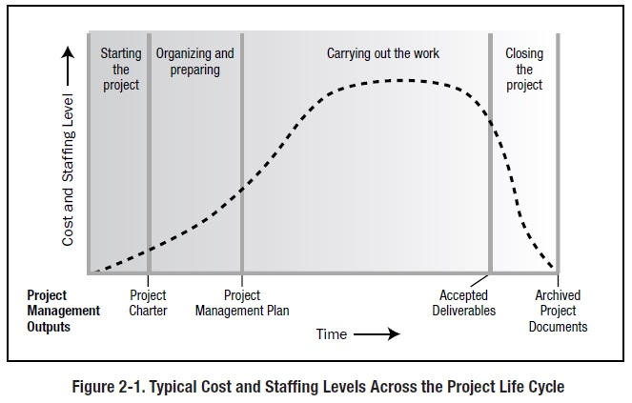
Generic Life Cycle Structure: General Characteristics
  Cost and staffing levels are low at the start, peak as the work is carried out, and drop rapidly as the project draws to a close.

Slide 46
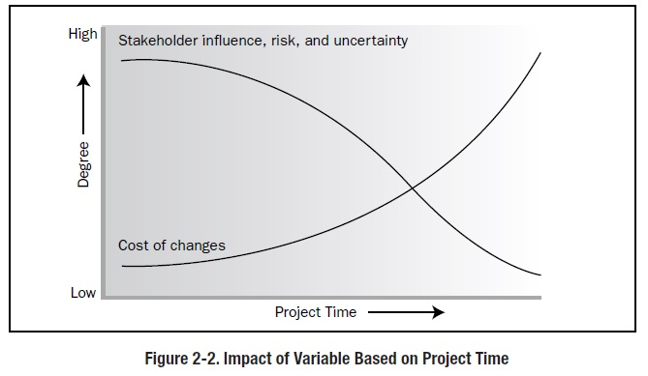
  Stakeholder influences, risk, and uncertainty are greatest at the start of the project. These factors decrease over the life of the project.
  Cost of changes: Ability to influence the final characteristics of the project’s product, without significantly impacting cost, is highest at the start of the project and decreases as the project progresses towards completion. The cost of changes and correcting errors typically increases substantially as the project approaches completion.

Slide 47
The Project Life Cycle - Overview
Generic Life Cycle Structure: The Need for More Control
Within the context of the generic life cycle structure, a project manager may determine the need for more effective control over certain deliverables.
Large and complex projects in particular may require this additional level of control. In such instances, the work carried out to complete the project’s objective may benefit from being formally divided into phases.

Slide 48
The Project Life Cycle -Phases

Slide 49
Project Phases
What are project phases?
Project phases are divisions within a project where extra control is needed to effectively manage the completion of a major deliverable.
Key Concepts:
Project phases are typically completed sequentially, but can overlap in some project situations.
Project phases are an element of project life cycle because of their high level nature.
A project phase is not a Project Management Process Group.

Slide 50
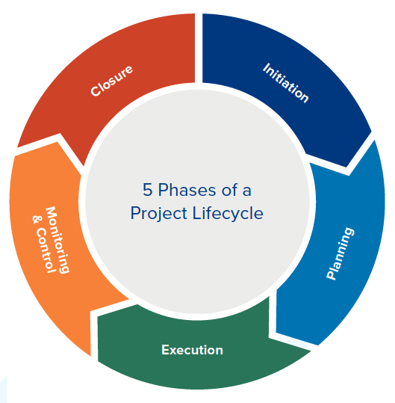
Project Phases
The phase structure allows the project to be segmented into logical subsets for ease of management, planning, and control.
The number of phases, the need for phases, and the degree of control applied, depend on the
  size,
  complexity, and
  potential impact of the project.

Slide 51
Contd…
Why do we do phasing? Or Why do we divide project into phases?
The phase structure allows the project to be segmented into logical subsets for ease of
management,
planning, and
control.

Slide 52
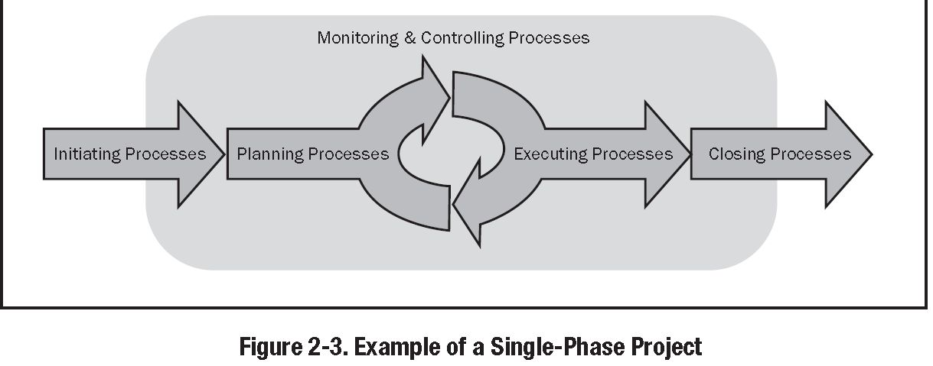
Although many projects may have similar phase name with similar outputs, few are identical. Some will have only one phase, and others may have many phases.
Different phases typically have a different duration or length. One project team might divide a project into two phases where a different team might choose single phase. So it depends on the nature of the project and the style of project team or organization.

Slide 53
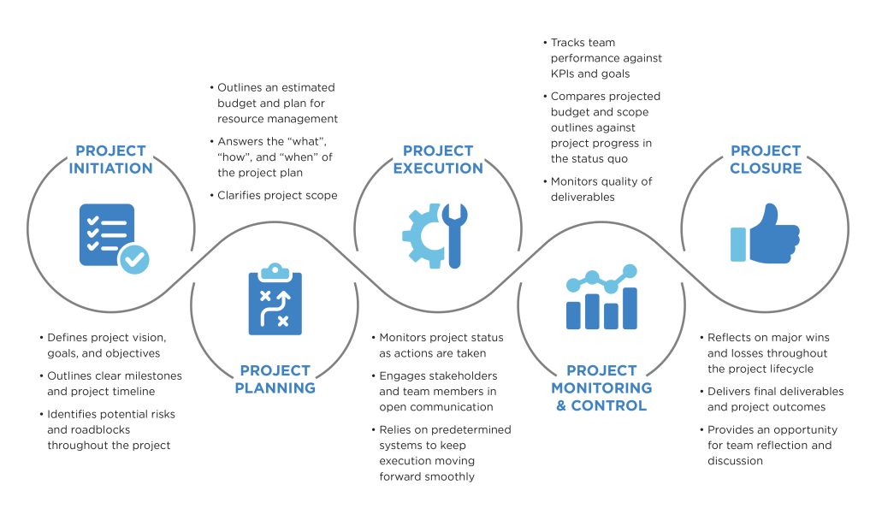
5 Phases of Project Management Life Cycle

Slide 54
The Project Life Cycle (Processes in Project)
Initiation Process
Planning Process
Defining the major goals of the project
Determining project selection criteria
Assigning the project manager
Obtaining the sign-off of the project charter
Determining project outputs
Writing and publishing a scope statement
Establishing a project budget
Defining project activities and estimates
Developing a schedule

Slide 55
The Project Life Cycle (Processes in Project)
Monitoring and Controlling Process
Execution Process
Developing and forming project team
Directing and leading the project team
Obtaining other project resources
Conducting status review meetings
Communicating project information
Managing project progress
Implementing quality assurance procedures
Measuring performance against the plan
Taking corrective action when measures are outside the limits
Evaluating the effectiveness of the corrective actions
Ensuring that project progress continues according to the plan
Reviewing and implementing change requests

Slide 56
The Project Life Cycle (Processes in Project)
Closing Process
Obtaining acceptance of project outputs
Documenting the lessons learned over the course of the project
Archiving project records
Formalizing the closure of the project
Releasing project resources

Slide 57
Phase-to-Phase Relationships

Slide 58
Phase-to-Phase Relationships
In multi-phased projects, the phases are part of a generally sequential process designed to ensure proper control of the project and attain the desired product, service, or result.
However, there are situations when a project might benefit from overlapping or concurrent phases.

Slide 59
Phase-to-Phase Relationships
There are three basic types of phase-to-phase relationships:
  A sequential relationship
  An overlapping relationship
  An iterative relationship

Slide 60
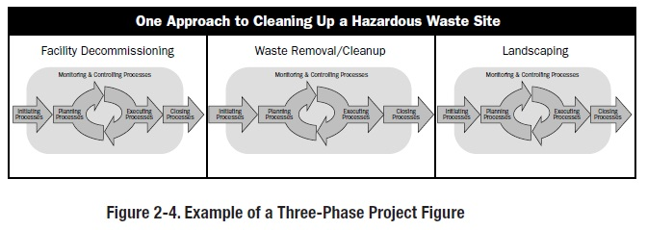
Sequential Phase Relationship
A sequential relationship, where a phase can only start once the previous phase is complete.
The step by step nature of this approach reduces uncertainty, but may eliminate options for reducing the schedule

Slide 61
Sequential Phase Relationship:
A sequential relationship, where a phase can only start once the previous phase is complete.
  Advantage of Sequential Phases:
  The step-by-step nature of this approach reduces uncertainty
  Disadvantage of Sequential Phases:
  Eliminate options for reducing the schedule.

Slide 62
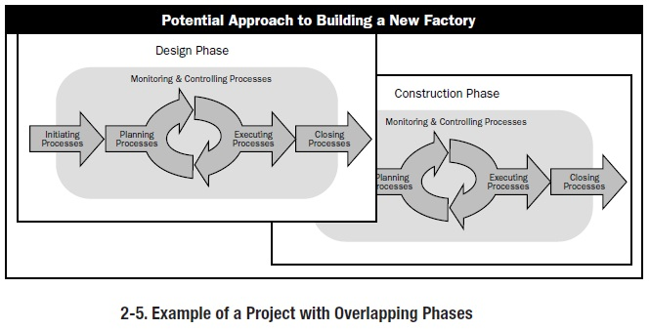
Overlapping Phase Relationship:
An overlapping relationship, where the phase starts prior to completion of the previous one.
  Advantage(s) of Overlapping Phase Relationship:
  This can sometimes be applied as an example of the schedule compression technique called fast tracking.
  Disadvantage(s) of Overlapping Phase Relationship:
  May increase risk
  Can result in rework if a subsequent phase progresses before accurate information is available from the previous phase.

Slide 63
Iterative Phase Relationship:
  An iterative relationship, where only one phase is planned at any given time and the planning for the next is carried out as work progresses on the current phase and deliverables.
  Advantage(s) of Overlapping Phase Relationship:
  This approach is useful in largely undefined, uncertain, or rapidly changing environments such as research,
  Disadvantage(s) of Overlapping Phase Relationship:
  It can reduce the ability to provide long term planning.
  The scope is then managed by continuously delivering increments of the product and prioritizing requirements to minimize project risks and maximize product business value.
  It also can entail having all of the project team members available throughout the project or, at a minimum, for two consecutive phases.

Slide 64
Phase-to-Phase Relationships (Contd…)
For multi-phase projects, more than one phase-to-phase relationship could occur during the project life cycle.
Considerations such as
level of control required,
effectiveness, and
degree of uncertainty
determine the relationship to be applied between phases.
Based on those considerations, all three relationships could occur between different phases of a single project.

Slide 65
Product Vs Project Life Cycle

Slide 66
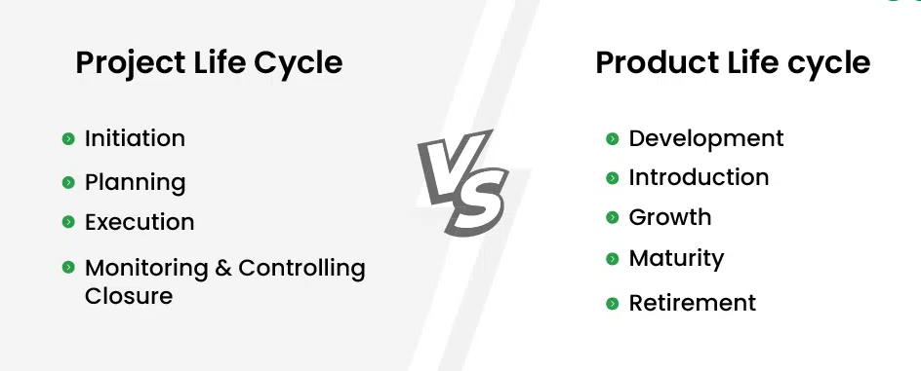
Product Vs Project Life Cycle

Slide 67
The Project Life Cycle - Overview
Product Life Cycle Vs Project Life cycle
A product life cycle is the amount of time a product goes from being introduced into the market until it's taken off the shelves.
There are four stages in a product's life cycle—introduction, growth, maturity, and retirement..
The last product life cycle phase for a product is generally the product’s retirement.
Project life cycles occur in one or more phases of a product life cycle.
All projects have a purpose or objective, but in those cases where the objective is a service or result, there may be a life cycle for the service or result, not a product life cycle.

Slide 68
Product Life Cycle Timeline
Introduction
Growth
Maturity
Retirement
Pick a product: WhatsApp · Careem · Nokia 3310
1
Where is it on the life cycle today?
2
List five projects that happened during its life
3
Place each project on the stage where it happened
Notes:
1. "Where is this product today?"
- WhatsApp: maturity. Careem ride-hailing: maturity (moving into a wider "super app"). Nokia 3310 (original): retired, then relaunched in 2017 as a new product.
2. What happened to projects during its life and place each on the stage, e.g. for WhatsApp: building the first version (introduction), adding voice/video calling (growth), end-to-end encryption rollout (growth/maturity), launching WhatsApp Business (maturity), dropping support for old phones (retirement of older versions).
3. Key insight: one product, many projects - each with its own start and end. The project life cycle sits INSIDE the product life cycle.

Slide 69
The Project Life Cycle - Overview
Examples:
When the output of the project is related to a product, there are many possible relationships.
For instance, the development of a new product could be a project on its own.
Alternatively, an existing product might benefit from a project to add new functions or features, or a project might be created to develop a new model.
Many facets of the product life cycle lend themselves to being run as projects, for example, performing a feasibility study, conducting market research, running an advertising campaign, installing a product, holding focus groups, conducting a product trial in a test market, etc. In each of these examples, the project life cycle would differ from the product life cycle.

